Slide 1
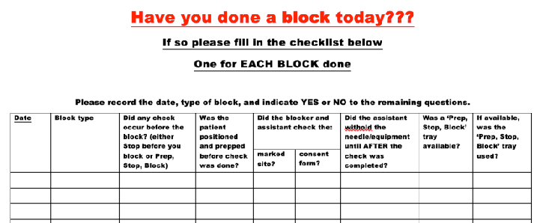
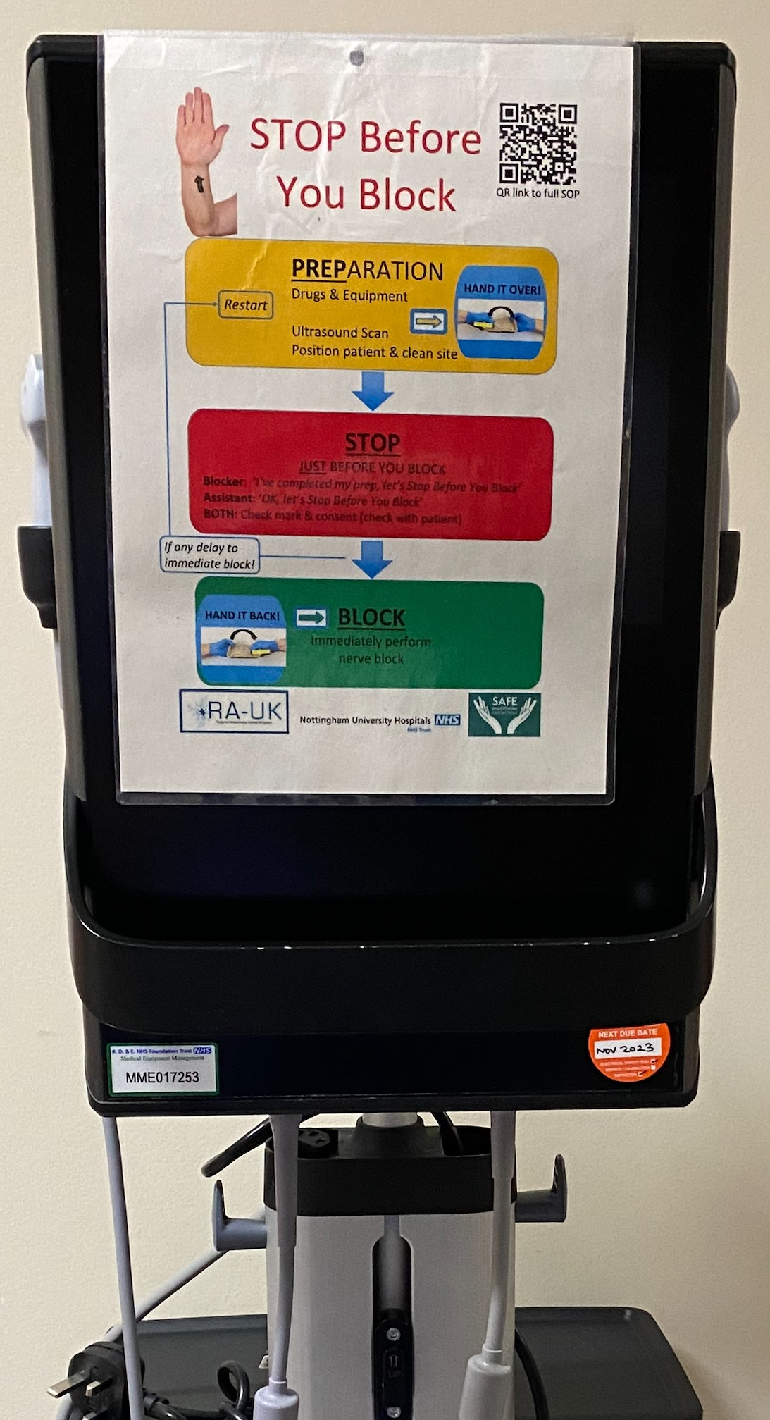
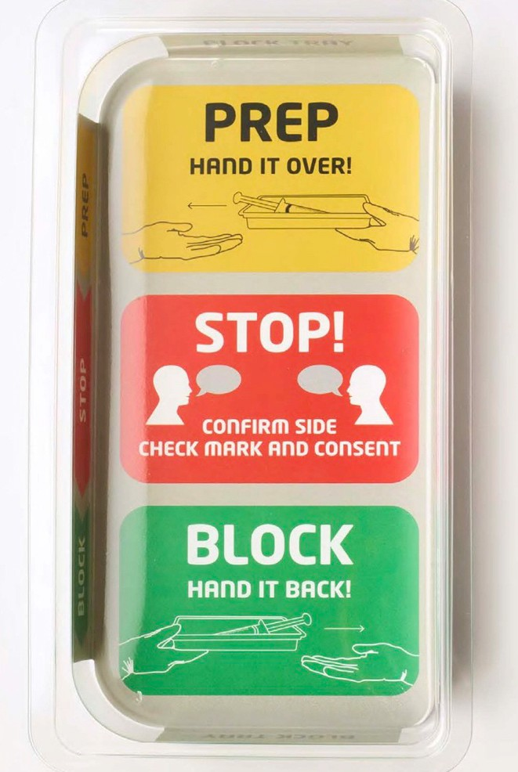
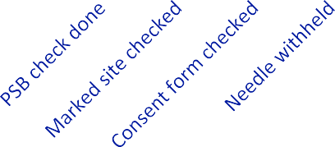
Audit of Regional Anaesthetic Practice and Safety Measures to Avoid Wrong Site Blocks at Royal Devon & Exeter Hospital
Dr Rebecca Wilcock, CT2 Anaesthetics Dr Helen Gilfillan, Consultant Anaesthetist
Introduction
A wrong site block is a rare but important complication in
the perioperative period. Since 2015 they have been deemed a never event – that is a “wholly preventable” event that should be avoided by “strong systemic protective barriers” that are implemented by all healthcare providers^{. 1} We estimate that between 5000 and 6000 peripheral nerve blocks are performed each year by anaesthetists in the Eastern Division of Royal Devon University Hospitals Trust. A previous audit (July 2022) demonstrated a 90% compliance with ‘Stop Before You Block’ moment but the majority were not performed in the recommended ‘Prep Stop Block’ format.² This audit aimed to evaluate our current adherence to the “Prep Stop Block” moment at the Royal Devon & Exeter Hospital.
Image 1 (above) – Data collection sheet
Results
We audited a total of 102 blocks. Our current practice when compared to national standards is demonstrated in Graph 1. Notably, in 100% of blocks we are correctly using the “Prep Stop Block” format.
Methods
Data was collected between 21/11/2022 – 23/12/2022 in
fourteen theatres for a number of national and local standards. A data collection sheet was placed in each anaesthetic room and all staff that were present for a block were asked to complete the questions for each block performed. The data sheet can be seen in Image 1.
100
80
60
40
20
0
Image 2 (above) – Prep Stop Block trays
Image 3 (above) – PSB reminder posters on ultrasound machines in theatre
Conclusions
As we are not yet 100% compliant with national and local standards, we will seek to improve a number of factors. We recommend that all staff who are involved in regional anaesthesia undergo a refresher teaching session on “Prep Stop Block”. This will include a demonstration and simulation of the process at our monthly department Audit & Education Meeting.
Furthermore, we hope to acquire more PSB equipment trays and ensure posters are present and visible in each anaesthetic room. We should also ensure continuity of the new “Prep Stop Block” guidance and remove any old “Stop Before You Block” posters to avoid any confusion for staff.
We will aim to repeat this audit in 6 months time.
National Standards
1. Prep Stop Block format should be used
Yes
No
2. Needle should be withheld from blocker until check
is complete
3. Both the blocker and assistant should check the marked site and the consent form to confirm site to be blocked
Local Standards:
To help prompt users to do PSB, we have equipment trays with the PSB reminder printed on the base as a visual prompt (Image 2). These should be available in all theatres where regional anaesthesia is performed.
“Prep Stop Block” posters should be present and
visible in all anaesthetic rooms and on ultrasound machines.
In terms of local standards, PSB trays were only available in 50% of theatres, and when present, were not being used 100% of the time.
10 out of 14 theatres and 3 out of 4 ultrasound machines had either no
poster or out of date “Stop Before You Block” poster.
References
NHS England. Never Events policy and framework. January 2018. https://www.england.nhs.uk/wp-content/uploads/2020/11/Revised-Never-Events-policy- and-framework-FINAL.pdf
RA-UK. Standard Operating Procedure for Prep Stop Block. Available at https://www.ra-uk.org/index.php/prep-stop-block

